Slide 1


Azure SQL for Beginners Performance Troubleshooting High CPU due to lack of resources
Special Edition
#azuresql
aka.ms/azuresql4beginners

Slide 2


Performance is “slow” = Running vs Waiting
Low or
no CPU
High CPU
What queries are the top resource consuming queries or are waiting?

Slide 3



Running vs Waiting Scenarios
High CPU
Waiting
Missing Index
Blocking
Anti-pattern queries
Deadlocks
Lack of resources
Memory Grants

Slide 4
Purchasing models – Azure SQL Database
DTU model
Simple, preconfigured
vCore model
Independent scalability
Compute
Compute
Microsoft’s recommendation
Storage
Storage
Pre-packaged, bundled unit that represents the database power
Designed for predictable performance, but somewhat inflexible and limited in options
DTU sizing offers simplicity of choice
This model allows you to independently choose compute and storage resources. It also allows you to use Azure Hybrid Benefit for SQL Server and Reserved Capacity to gain cost savings.
Best for customers who value flexibility, control and transparency

Slide 5

Service tiers
General purpose
Business critical
Hyperscale
Most business workloads
Workloads that require low latency, fast recovery, and a readable secondary
Most business workloads with highly scalable storage and read-scale requirements
Remote storage
Local storage
Local + remote storage
IOPS
$
Provisioned or Serverless
IOPS++
$$$
In-memory
IOPS+
$$
Unlimited storage
P
P
S
S
R
P
R
R
R
R
Up to 30 named replicas
Elastic Pools

Slide 6
The troubleshooting process
Identify High CPU
Find Top Resource Consuming Query or Queries by CPU
Query could be fast for single execution
Has overall CPU usage gone up?
Are there waits on CPU?
Scale cores or use Serverless
Check if problem is resolved
Is there simply an increase in usage?
Check if query is tuned
Try it yourself at https://aka.ms/azuresqlworkshop

Slide 7
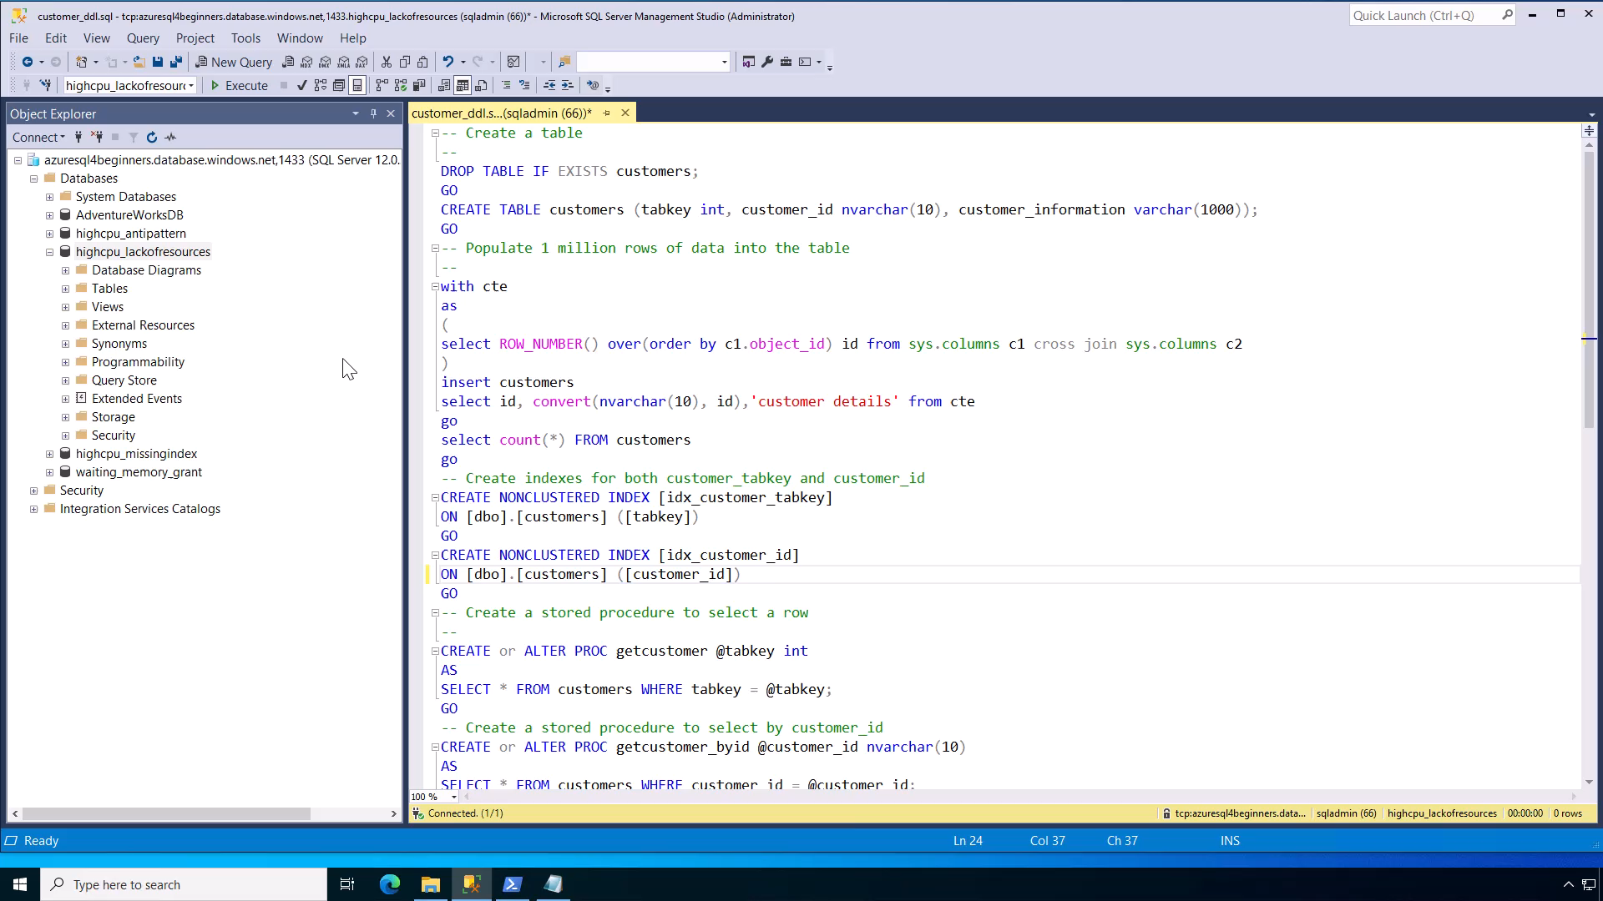
Notes:
30 secs

Slide 8
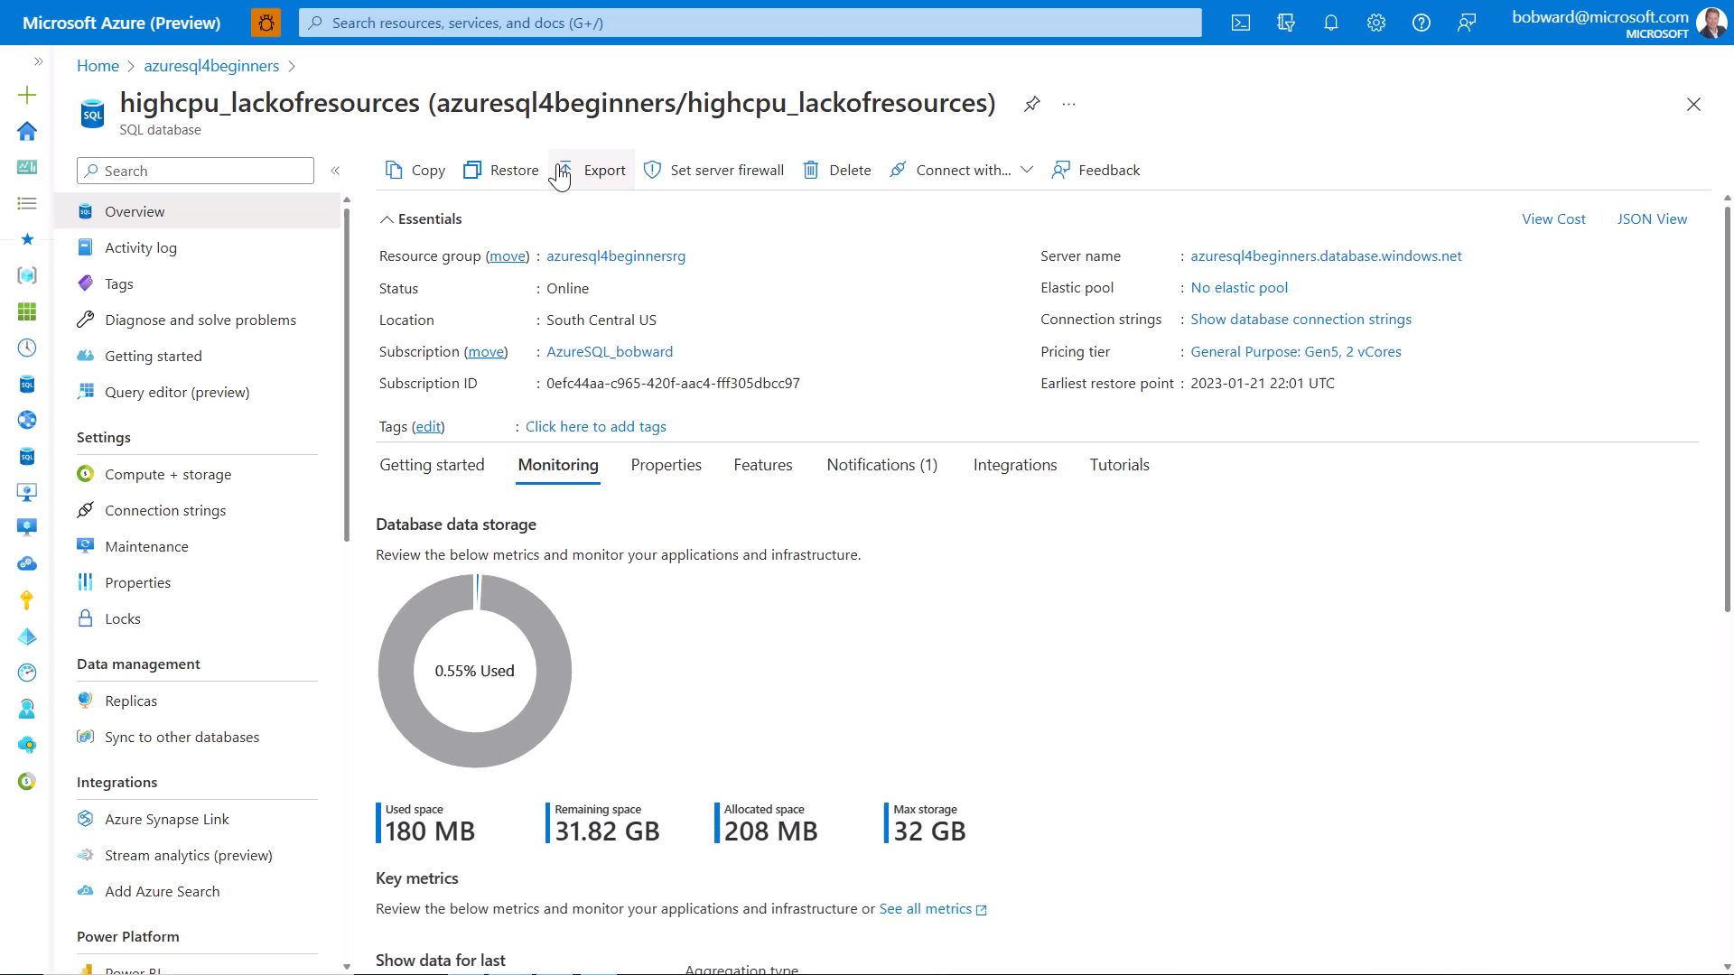
Notes:
45 secs

Slide 9
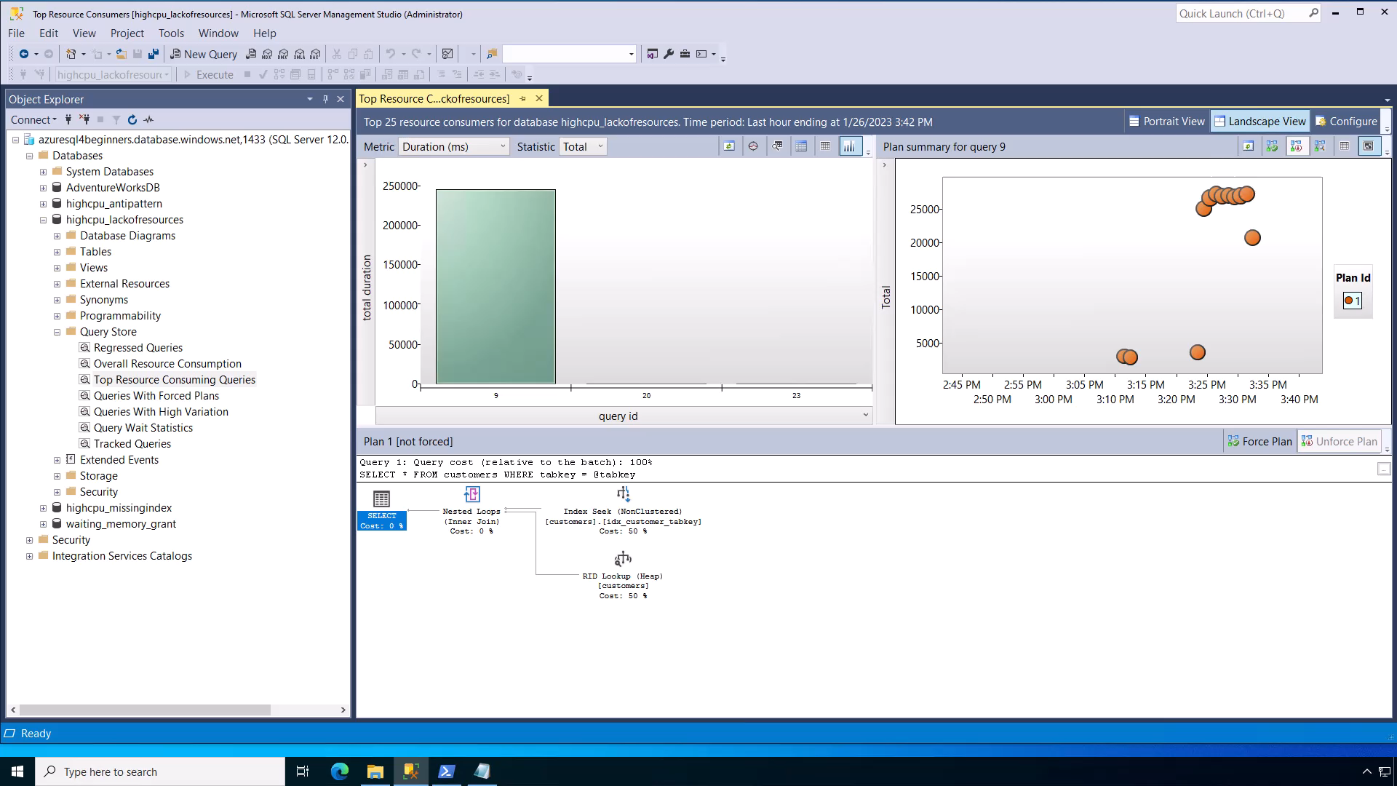
Notes:
1 min

Slide 10
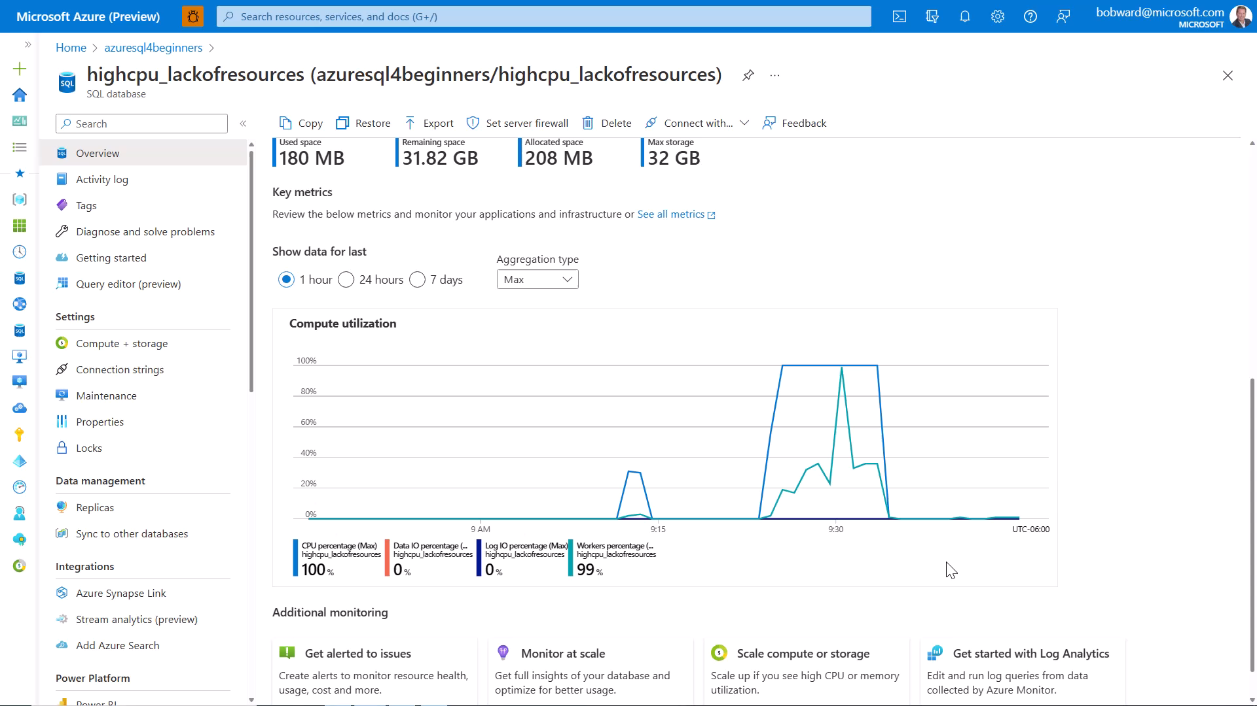
Notes:
1 min

Slide 11
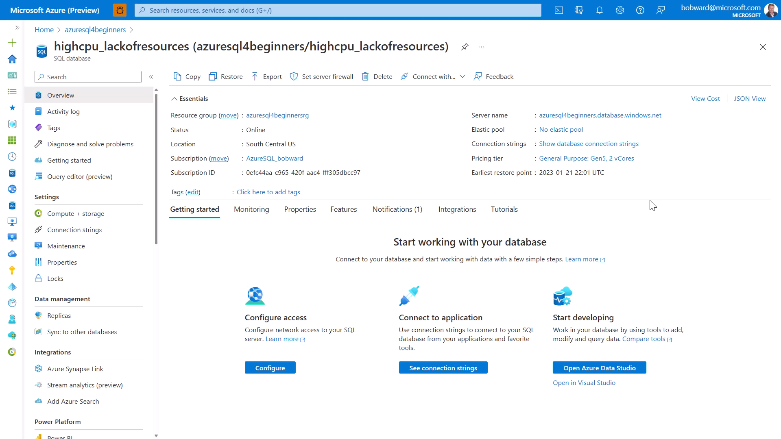
Notes:
1 min

Slide 12
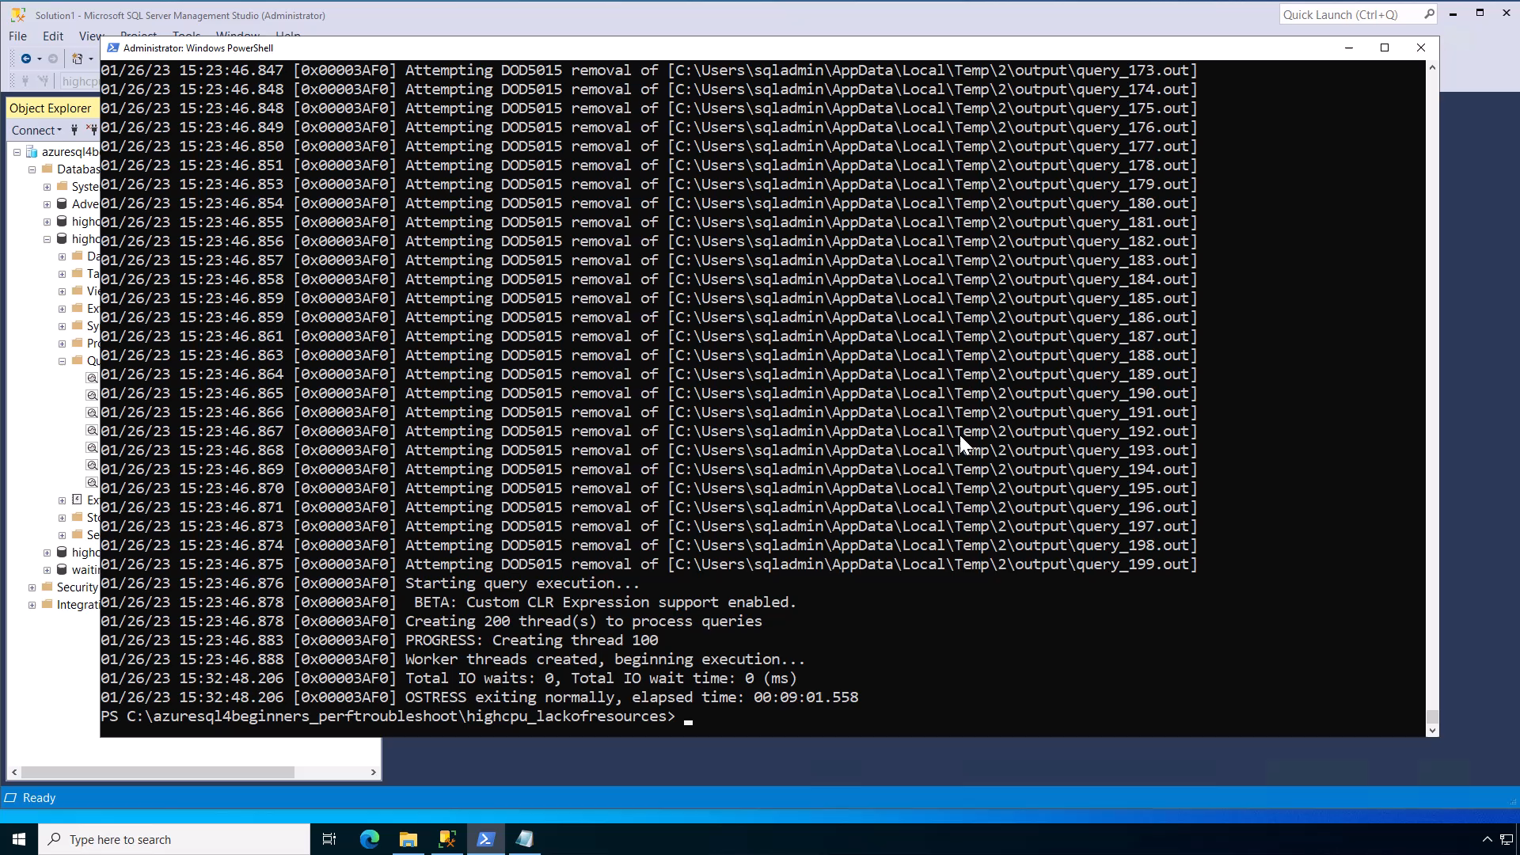
Notes:
30 secs

Slide 13
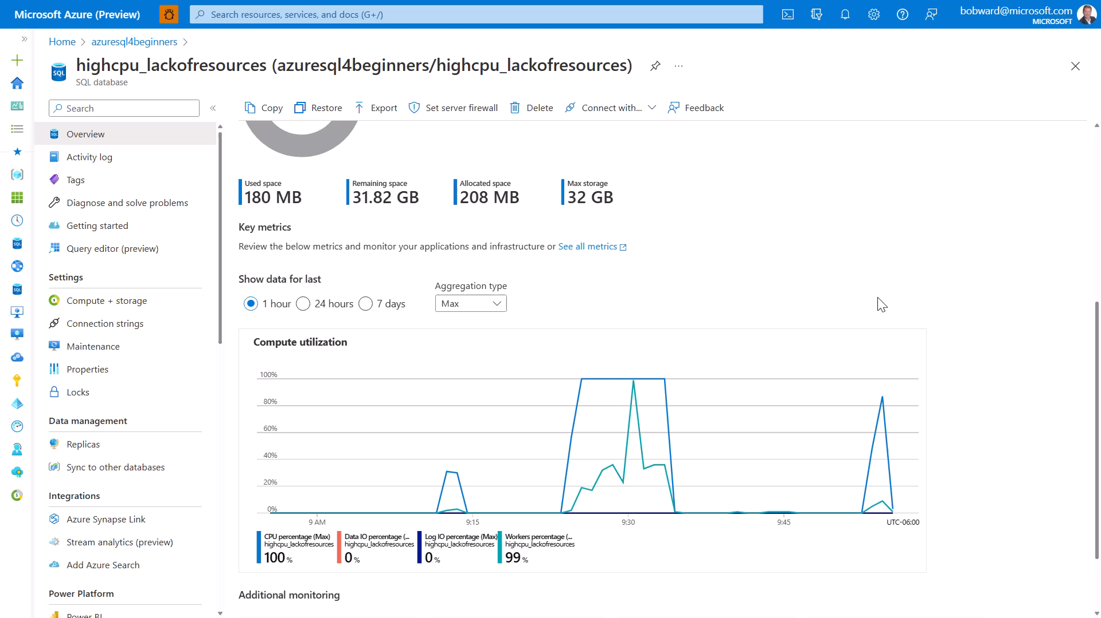
Notes:
1 min 30 secs
Demo total = 6 mins

Slide 14
Summary
SQL performance problems are either running or waiting.
SQL performance problems typically involve finding out what queries are involved.
If you identify a High CPU problem, find the top resource consuming query or queries by CPU.
Query could be fast and turned, but current deployment may not handle increase in usage.
Scale database without migration or use Serverless for autoscsale

Slide 15


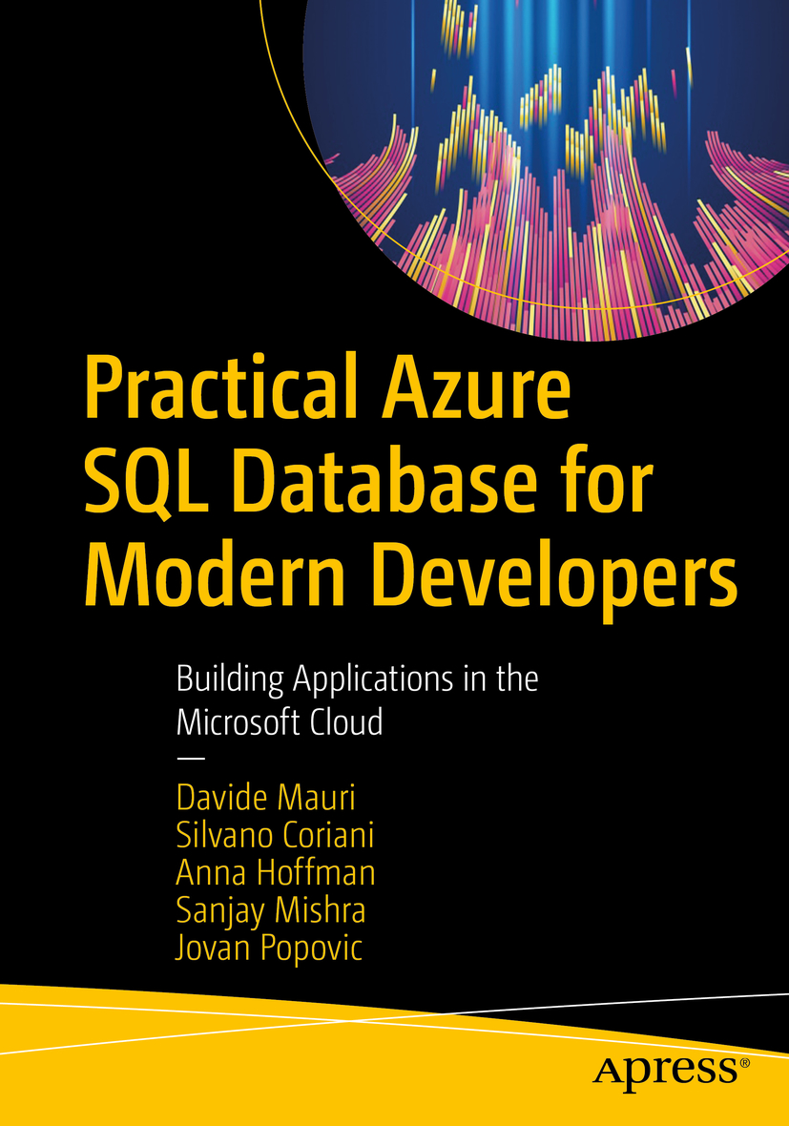


Learn more
Azure SQL Database vCores
aka.ms/azuresqldbvcore
vCore
Azure SQL for Beginners
aka.ms/azuresql4beginners
Azure SQL Workshop
aka.ms/azuresqlworkshop
aka.ms/azuresqlbook
Azure SQL Fundamentals
aka.ms/azuresqlfundamentals
Watch Data Exposed
aka.ms/dataexposed
See more videos from our team
aka.ms/azuresqlyt
Follow us on social media
aka.ms/azuresqltwitter
aka.ms/azuresqlfordevelopers

